Slide 1

By
Hamdi Boukamcha

Slide 2

Ear features have been used for many years in the forensic science of recognition
Ear is a stable biometric and does not very with age.
Ear has all the properties that a biometric trait should have, i.e. uniqueness, universality, permanence and collectability
Hamdi Boukamcha

Slide 3

Ear does not have a completely random structure. It has standard parts as other biometric traits like face
Unlike human face, ear has no expression changes, make-up effects and more over the color is constant through out the ear.
Hamdi Boukamcha

Slide 4
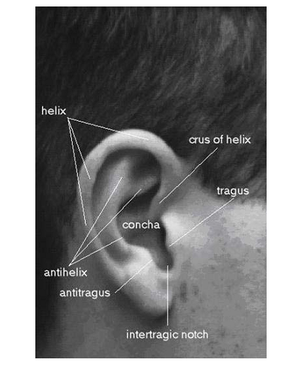
Fig 1: Anatomy of the Ear
Hamdi Boukamcha

Slide 5

Image Acquisition
Pre-Processing and Edge Detection
Feature Extraction
Two-Stage Classification
Hamdi Boukamcha
Notes:
<number>11/07/26

Slide 6

The side face images have been acquired in the same lightening conditions.
All Images taken from with a distance of 15-20 cms between the ear and camera
The image should be carefully taken such that outer ear shape is preserved.
The less erroneous the outer shape is the more accurate the results are.
Hamdi Boukamcha

Slide 7
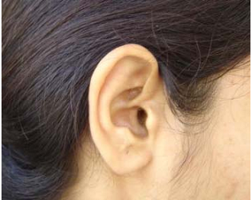
Fig 2: A side face image acquired
Hamdi Boukamcha

Slide 8


Selecting the ROI portion of the image by segmentation.
Color image is then converted to grayscale image
  Fig 3: Cropped Gray scale image
Hamdi Boukamcha

Slide 9

Edge detection and binarization is done using the well known canny edge detector.
If w is the width of the image in pixel and h is the height of the image in pixel, the canny edge detector takes as input an array w × h of gray values and sigma (standard deviation)
Output a binary image with a value 1 for edge pixels, i.e., the pixel which constitute an edge and a value 0 for all other pixels.
Hamdi Boukamcha

Slide 10
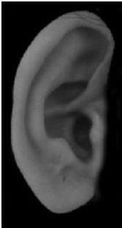
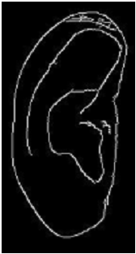
Fig 4: Grayscale image and its corresponding edge detected binary image
Hamdi Boukamcha

Slide 11
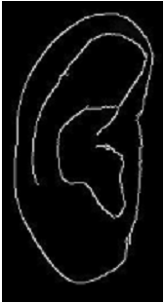
Using adaptive weighted median filter this kind of noise can be removed
Fig 5: image with and without noise
Hamdi Boukamcha

Slide 12

Here features extracted all are angles
Features are divided into two vectors
First features is found using the outer shape of the ear.
Second feature vector is found using all other edges
To find the angels, the terms max-line and normal line are used
Hamdi Boukamcha

Slide 13
Max-line: it is the longest line that can be drawn with both its endpoints on the edges of the ear.
The length of a line is measured in terms of Euclidean distance
If there are more than one line, features corresponding to each max-line are to be extracted
Hamdi Boukamcha

Slide 14
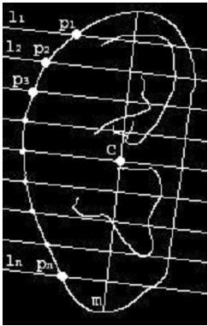
Normal Line: lines which are perpendicular to the max-line and which divide the max-line into (n+1) equal parts, where n is a positive integer.
Fig 5: Image with max-line and normal line
Hamdi Boukamcha

Slide 15
The max-line m, normal line l1,l2,l3,…..,ln named from top to bottom.
Center of the max-line is c.
P1,P2,P3,……,Pn are the points where the outer edge and the normal lines intersect.
Hamdi Boukamcha

Slide 16
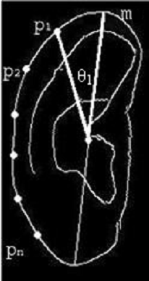
First feature vector(FV1): it can be defined by.
FV1 = [θ1, θ2, θ3,…., θn]
Fig 6: image showing the angel θ1
Hamdi Boukamcha

Slide 17
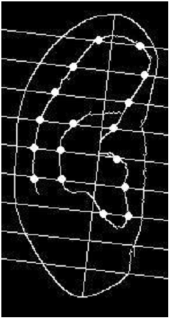
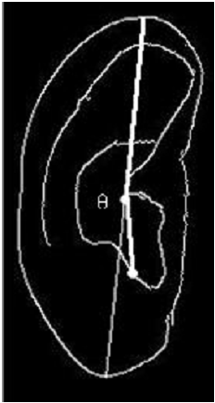
Second feature vector(FV2): all the points where the edges of the ear and normal line intersect except the outer most edge
Fig 7: image showing second feature vector and angel respectively
Hamdi Boukamcha

Slide 18

Classification is the task of finding a match for a given query image.
Here classification is performed in two stages.
In first stage the first feature vector is used while in second stage second feature vector is used.
Hamdi Boukamcha

Slide 19
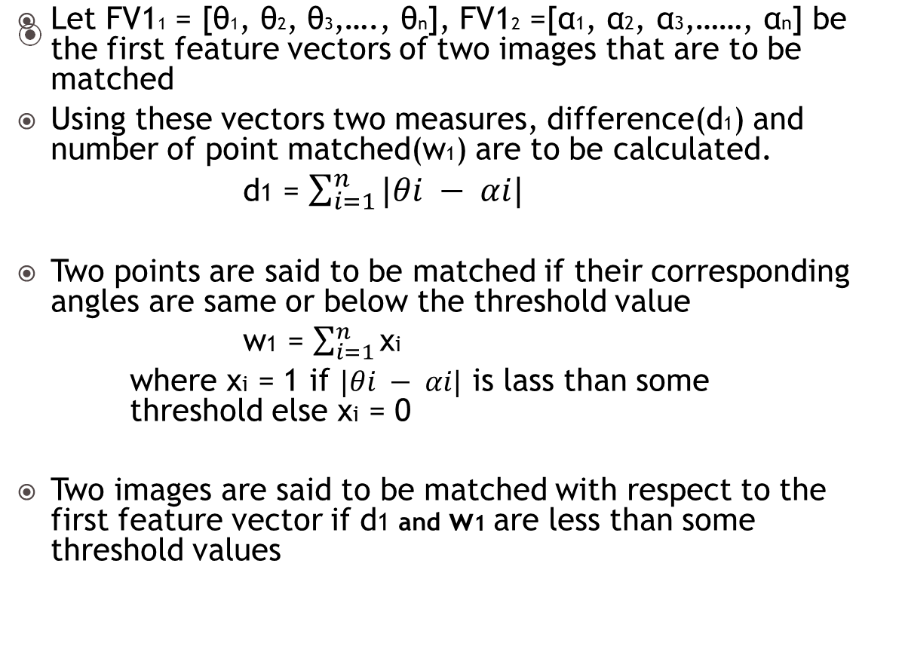
Hamdi Boukamcha

Slide 20

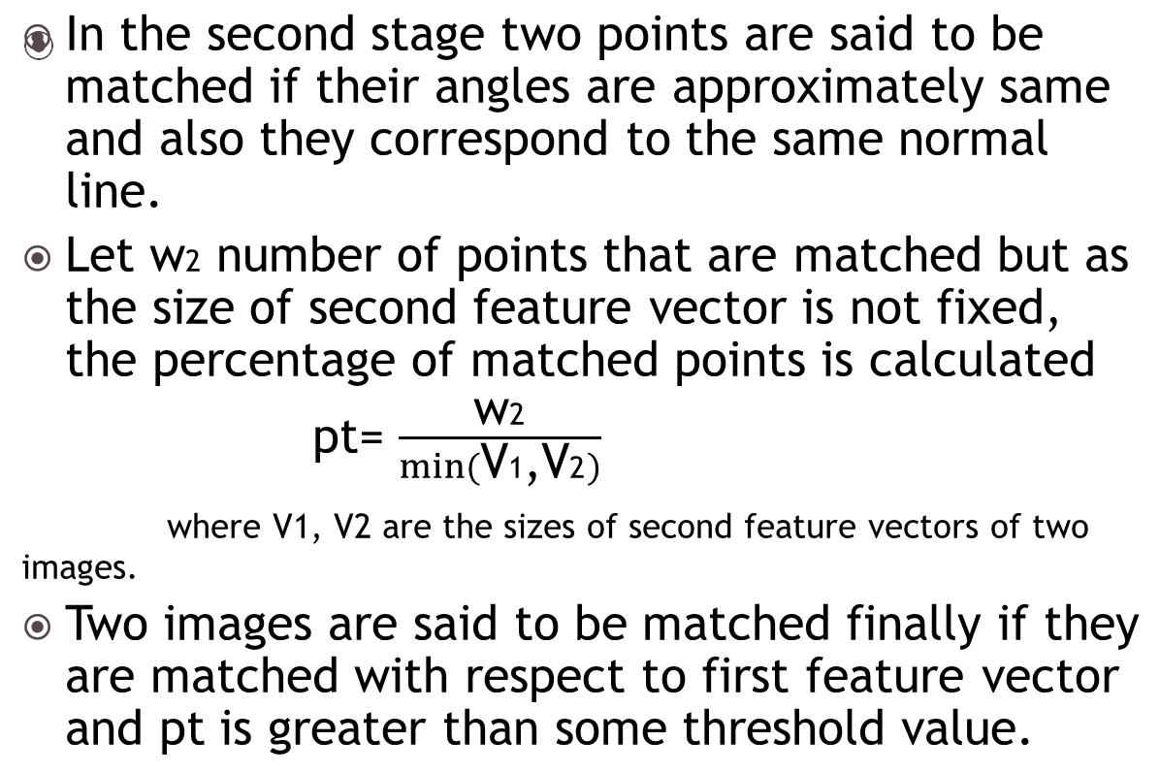
Hamdi Boukamcha

Slide 21

A given query image is first tested against all the images in the database using first feature vector
Only the images are matched in the first stage are considered for second stage of classification
As the size of the FV1 is less, that is n (number of normal line) so only n comparison is needed for the first stage classification.
In the second stage classification m*n comparison are required, assuming m points for each normal line.
If the classification is single stage, than total comparison required are I*((n)+(m*n)), where I is the number of images in the database
If the classification is divided into two stage the comparison would be I*n+I1*(m*n)
where I1 is the number of image that are matched with respect to the first feature vector.
Saved computation is (I – I1)*(m*n).
Hamdi Boukamcha

Slide 22

Ear recognition can used for both identification and verification purpose.
Since some portion of ear is kept covert by hair so it is very difficult to get the complete image of ear.
Since its uniqueness is moderate we can not rely on it completely.
Hamdi Boukamcha

Slide 23

Ping Yan, Kevin W. Bowyer, “Empirical Evaluation of Advanced Ear Biometrics”, IEEE Computer Society Conference on Computer Vision and Pattern Recognition , 2010
Michal choaras, “Ear biometric based on geometric al feature extraction”, Electronic letters on computer vision and image analysis(Journal ELCVIA), 585-95,2012.
Hamdi Boukamcha

